Slide 1
Research Like a Rebel
Neil Wieloch, PhD
Marketing Strategy & Insights
1-800 CONTACTS

Slide 2
Have We Lost Our Ability to Solve Problems?
Siloed – and getting siloeder
Insights without action
“Solutions” over problems
Expensive, useless liars
Waste

Slide 3
Two Conflicting Perspectives: Marketing Epistemology
Sub-fields:
Brand
Advertising
Data:
Awareness/Perception
Consideration
Segments/personas
Analysis:
Pre/post
Top-
Down
Bottom-
Up
Sub-fields:
Digital
CRM
Data:
Customer/Visitor
Path-to-purchase
Attribution
Analysis:
A/B

Slide 4
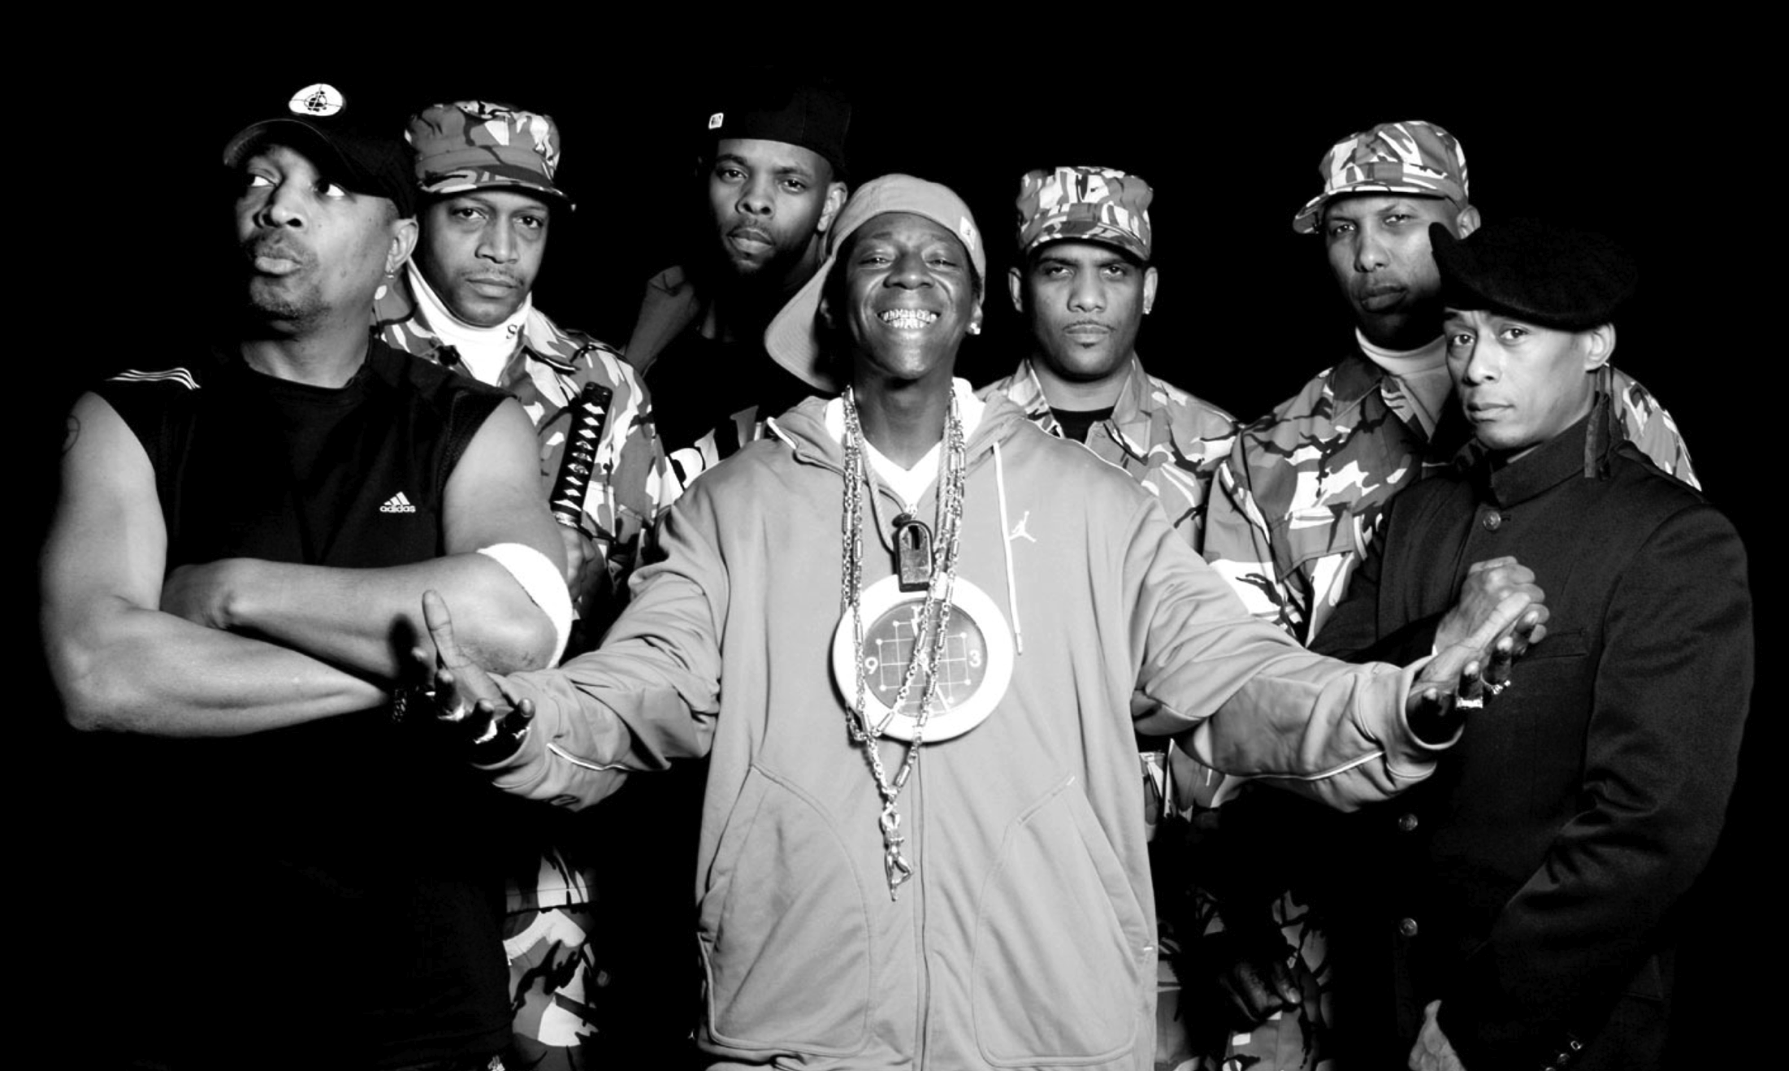
Rebellion: A Response to Conflicting Ideologies:

Slide 5
Two Conflicting Perspectives: Subcultures
Industrial Capitalist Society
Hierarchical power
Segregation
Parent Culture
Youth
Culture
Class oppression
Social division (class, ethnicity, gender)
Loss of community

Slide 6
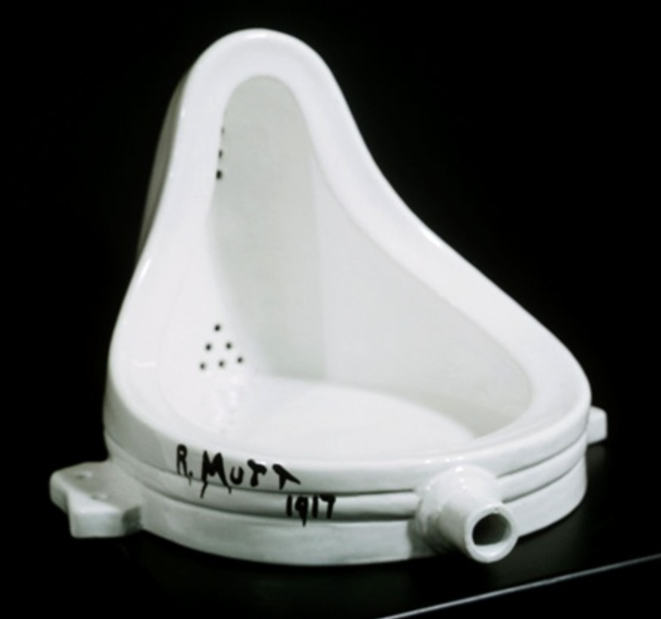
Our Goal:
Change the system
by changing the data

Slide 7
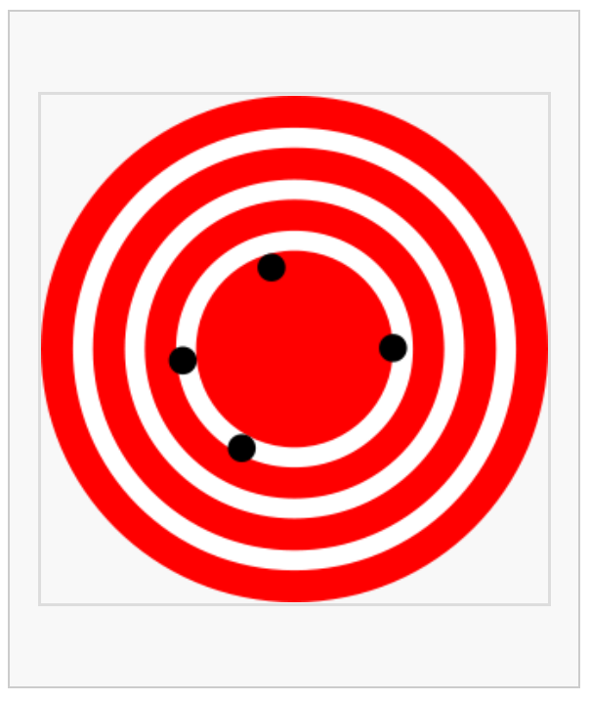
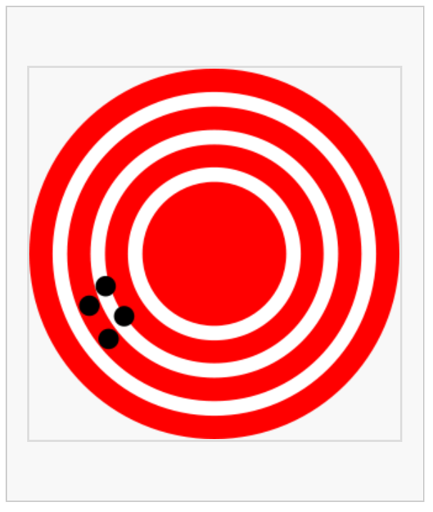
Our Approach: First Precision, Then Accuracy
Accuracy
Precision
Thank you Wikipedia for this great visual representation. And thank you Avinash Kaushik and Jim Novo for bringing this conversation to analytics: http://www.kaushik.net/avinash/emetrics-dc-07-reflections-accuracy-precision-predictive-analytics/

Slide 8
Starting with Predictive Analysis of Customer Behavior
Identify key business questions (linked to specific customer behavior)
Driver analysis
Outline top-down target strategy
Non-Customer Data
Customer Survey
Appended Customer Demographics & Psychographics
Customer Data
Customer Transactional
Behavior

Slide 9
Flagging and Scoring Individual Cases
Enhance dataset to act case-specifically:
Use look-alike data to flag segments
Score key predictive behaviors
Non-Customer Data
Key Flags (segments)
Customer Data
Key Predictive Scores
Look-alike scores

Slide 10
Next: Taking Analysis “Above the Line”
Our next step:
Append Customer Data with Digital Behavior Data
Target look-alike Digital Behavior among Non-Visitors
Non-Customer Data
Customer Data

Slide 11
Research Like a Rebel (turn convention on its head)
First play the prisons
(start at the bottom)
Wear black
(be your own expert)
One piece at a time
(DIY)
Act unapologetically
(adopt a punk attitude)
Johnny Cash

Slide 12
First Play the Prisons
Your customer data is your foundation.
Get your hands dirty by connecting directly and often with it.
This is where everything meaningful comes from.
You can’t be effective at the top without being grounded at the bottom.

Slide 13
Wear Black
Don’t let anyone tell you what you should do.
You are your own best expert.
No one knows you or your business better than you.
Don’t ever forget that.

Slide 14
The data is yours – and should only be yours.
Build it out and make it better – but keep it to yourself.

Slide 15
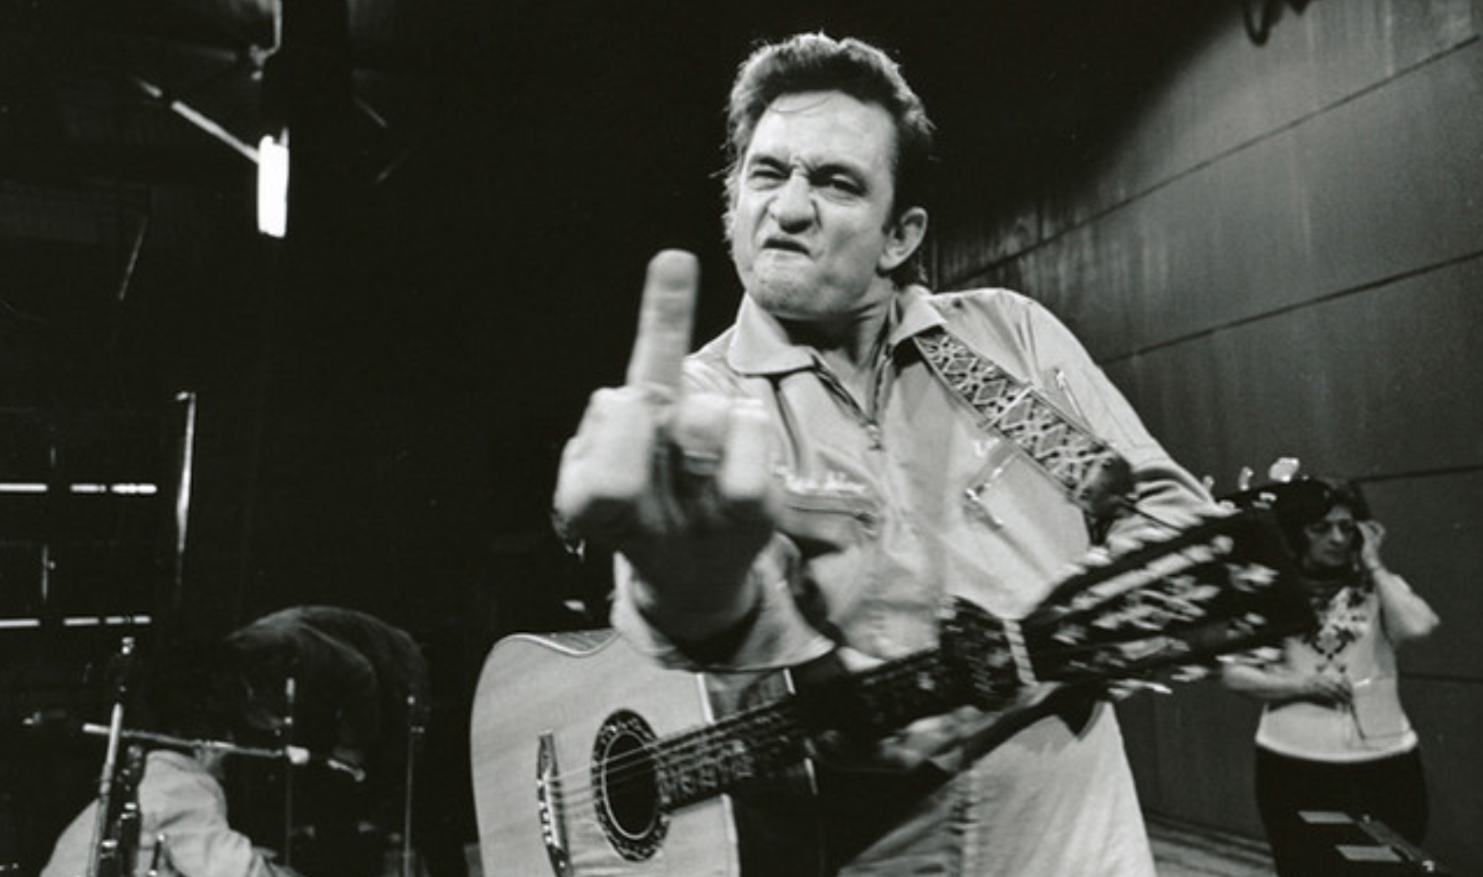
Act Unapologetically
You are in the best position help lead your organization.
Now go turn it on its head.

Slide 16
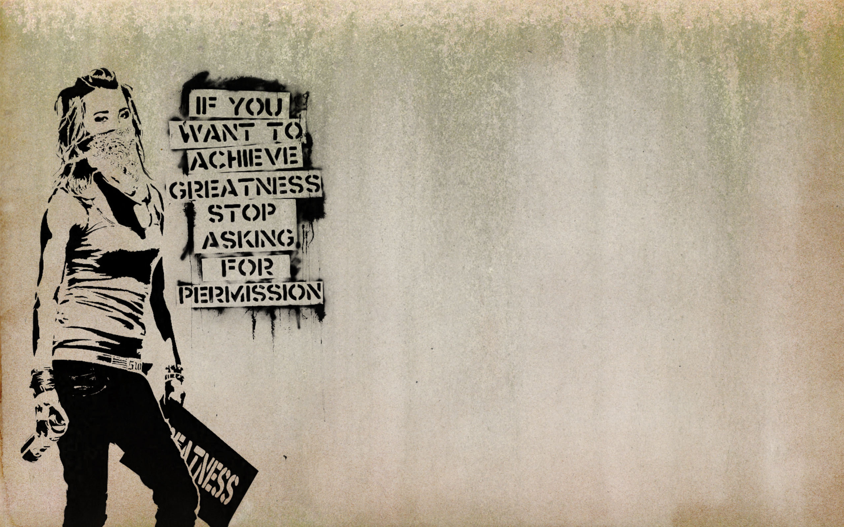
Research is an Act of Resistance
Trust your gut.
Your gut is always questioning.
Your gut obsessively analyzes everything – all the time.
Your gut is continuously engaged in the constant pursuit of understanding.
You expose your gut to more information and knowledge than most.
Your gut is meticulously thoughtful.
Your gut has an incredible understanding of what’s going on.
Few guts are better equipped to help lead others in the right direction.
Trust your gut and make some trouble.

