Slide 1
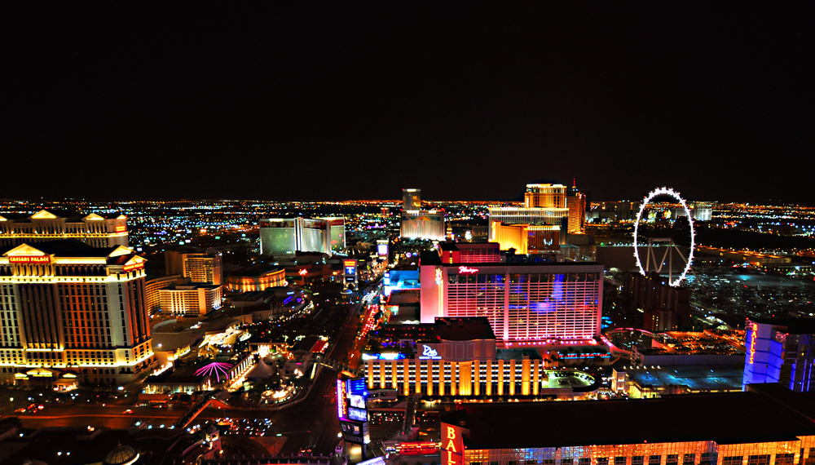
The Dimensionalization of Las Vegas Brand Values:
Relevant Elasticity in the Face of Changing Consumer and Societal Values

Slide 2
Insights
Mike Dabadie, Heart+Mind Strategies

Slide 3
A values revolution is reshaping the consumer marketplace. Companies, regardless of their size or target market, must understand the significance of this social trend.
Spend Shift: How the Post Recession Values Revolution is Changing the Way We Buy, Sell, and Live
– John Gerzema

Slide 4
Consumers Looking for New Brand Relationships
Leader
Exclusive
Sensuous
Daring
Trendy
Socially Responsible
Friendly
NON-JUDEGMENTAL
CARING
INCLUSIVE

Slide 5
DISRUPTION
of the traditional Value
Proposition

Slide 6
Redefining the Value Proposition
Value delivered based on the need of the organization and the customer.
Value delivered through shared individual, societal, and brand values.

Slide 7
Individual and Societal Values
ACCOMPLISHMENT
Achievement, success, influence
LOVE
Romantic love, family love, deep affection for others
BELONGING
Member of a group/cause, shared relationships, inclusive
PEACE OF MIND
Absence of mental stress or anxiety, relaxed
CARING
Helpful, compassionate, caring acts, forgiving, loyal, responsible
PLURALISM
Non-judging, accepting of others
ENJOYMENT
Enjoying life, pleasure, having fun
POWER
Social power, authority, wealth, preserving public image
EXCITEMENT
Exciting life, varied life, adventurous, new experiences
SECURITY
Personal, family, or national security, social order
FREEDOM
Independence, self-direction, creativity, choosing own goals
SELF-ESTEEM
Self-respect, pride, confidence
FULFILLMENT
Satisfaction, happiness
TRADITIONAL
Respect for tradition, spirituality, devoutness, accepting my portion in life

Slide 8
I try to live my life by making decisions based on how…
I AM impacted by my choices and decisions
OTHERS ARE impacted by my choices and decisions
ACCOMPLISHMENT
ENJOYMENT
FULFILLMENT
LOVE
TRADITIONAL
FREEDOM
PEACE OF MIND
PLURALISM
BELONGING
SELF-ESTEEM
EXCITEMENT
POWER
SECURITY
CARING

Slide 9
Influence on the decision to travel to Las Vegas
How I AM impacted
Both equally
How OTHERS will be impacted

Slide 10
Life and Las Vegas Values
Overall Influence
in Life
Influence on
Selecting Las Vegas
CARING
EXCITEMENT
LOVE
ENJOYMENT
PEACE OF MIND
FREEDOM
SECURITY
FULFILLMENT
FREEDOM
ACCOMPLISHMENT
FULFILLMENT
POWER

Slide 11
GENERATIONAL Differences
POWER
PLURALISM
EXCITEMENT
FREEDOM
ENJOYMENT
ACCOMPLISHMENT
FULFILLMENT
GEN X
#WHHSH
BOOMERS
ONLY VEGAS
MATURE
MY VEGAS
MILLENNIAL
#FOMO

Slide 12
ADULT FREEDOM Brand Dimensionalization and Stretch
Indulge
Create, Relive Memories
Variety
Value
Celebration
Affordable
Non-judgmental
Adventure
Fun
Anonymous
Inclusive
Entertained
Rejuvenated
Free to Do
Transform

Slide 13
Marketing and Communications
Todd Gillins, R&R Partners

Slide 14
Adult Freedom

Slide 15
Results and Takeaways
Kevin Bagger, Las Vegas Convention and Visitors Authority

Slide 16
Las Vegas Visitor Volume
Million
42.3m

Slide 17
Las Vegas Room Inventory
Rooms
149,213

Slide 18
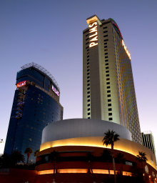
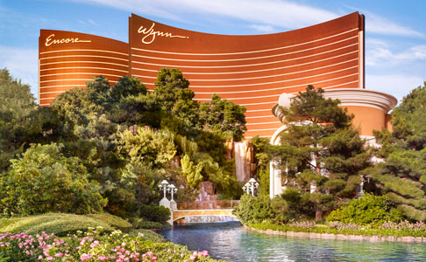
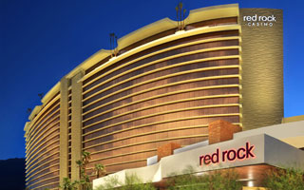
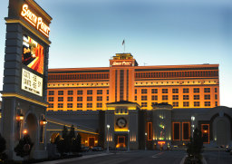
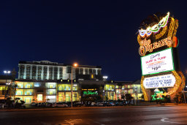
Palms
Red Rock
Wynn-Encore
South Point
Orleans

Slide 19
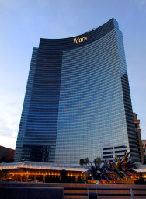
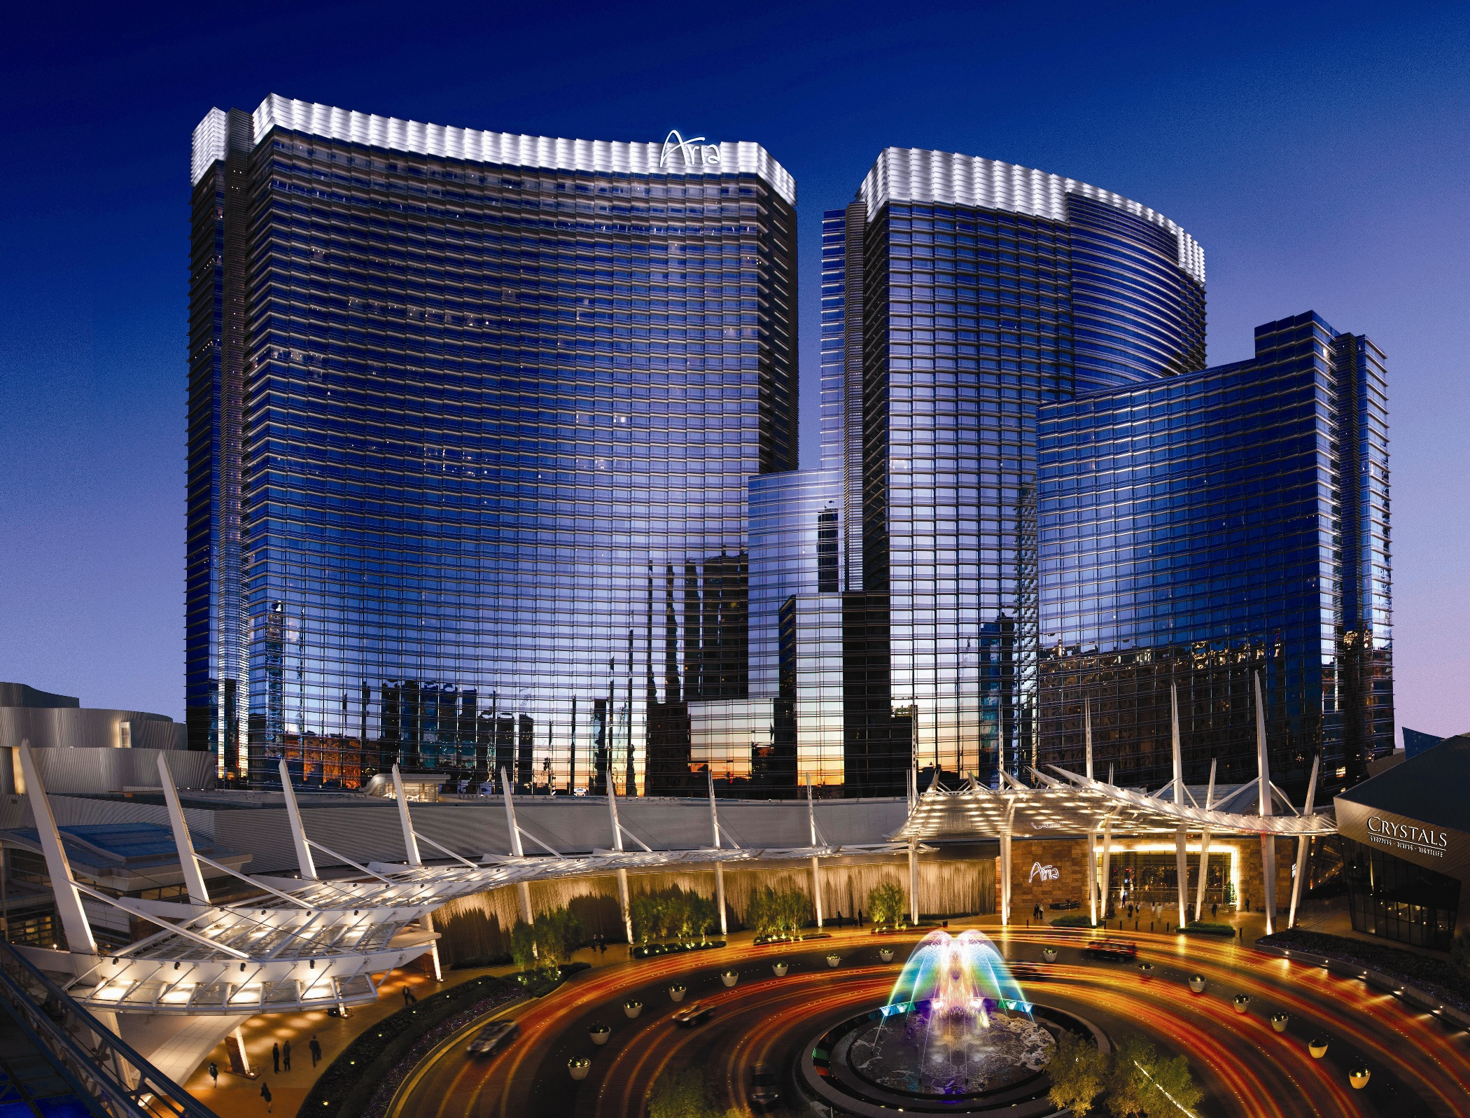
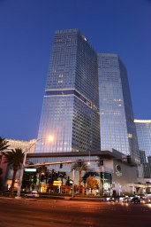
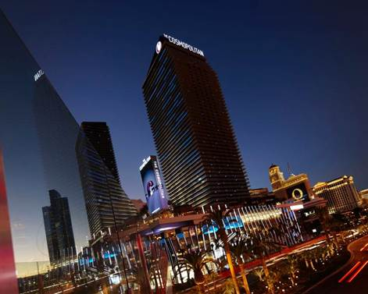
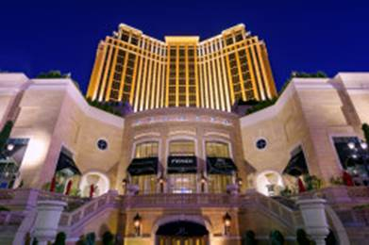
Vdara
Aria
Mandarin
Oriental
Palazzo
Cosmopolitan

Slide 20
Las Vegas Room Inventory
Rooms
Occupancy

Slide 21
Las Vegas Room Inventory
Rooms
Occupancy

Slide 22
2015 Occupancy
US Average
Las Vegas
Difference
22.1 pts

Slide 23
Las Vegas Brand: Beyond Gaming
Clark County Casinos: Gaming vs. Non-Gaming Mix

Slide 24
Takeaways
Personal and Societal Value(s) Proposition
Pluralism Rising (Millennials and Women)
Dimensionalization of Brand Promise
Interplay of Cognition & Emotion=Business Impact

Slide 25
Thank You!

