Slide 1
Creating and Managing SMB Insight Communities A Community Manager’s POV
Sharon Brant
Head of Market Insights

Slide 2
Building an online insights community is like… planning a (big) Thanksgiving Dinner
Considerations before starting
Decorations & Menu planning (Branding and Plan)
Invitations (Recruitment)
Activities
Party favors (Incentives)
Clean up & lessons learned

Slide 3
Considerations before starting
Purpose and objectives

Slide 4
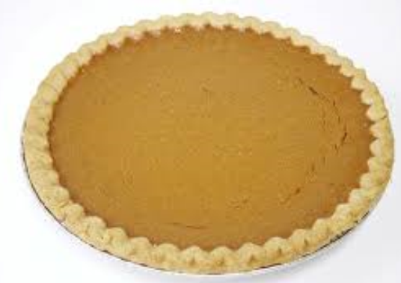
Purpose: Provide an agile and cost effective way to better understand SMB’s needs and challenges
Community Objectives
Position Vantiv as a trusted resource
Create a rich member experience
Provide members with exclusive information
Allow members ability to share

Slide 5
Considerations before starting
Use cases (input to activities)

Slide 6
Insight Communities provide value for a variety of uses
Marketing
Message testing
Segments
Content topic needs
Customer advocacy
Quick polls
Product
Concept testing
Prod Sat
Post pilot feedback
Buyer profiles
Ideation
Product optimizing
Price testing
Strategy
Ideation and screening
Risk assessment
Competitor assessment
Sales
Buyer journey
Buying criterion
Testimonials
UX
Website testing
Product testing
Innovation challenge

Slide 7
Additional considerations before starting
Host/Hostess
Support team
Guests
Budget
Cook or cater

Slide 8
Menu Planning & Decorating

Slide 9
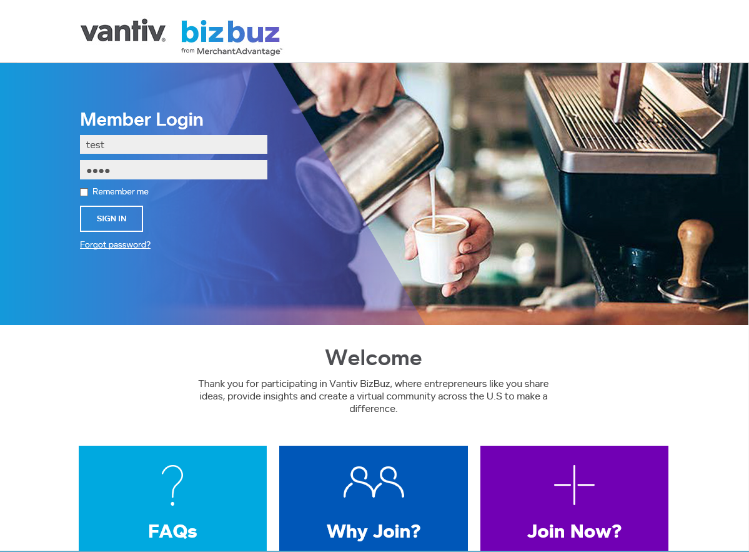

Slide 10
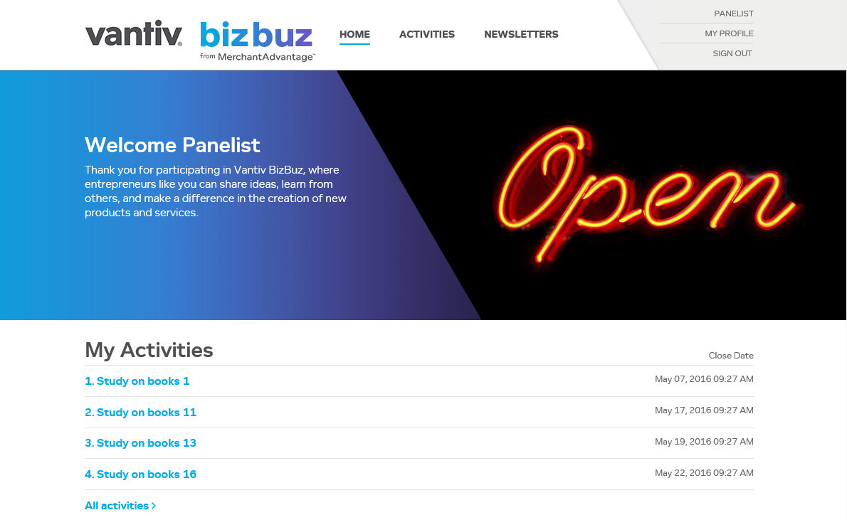

Slide 11
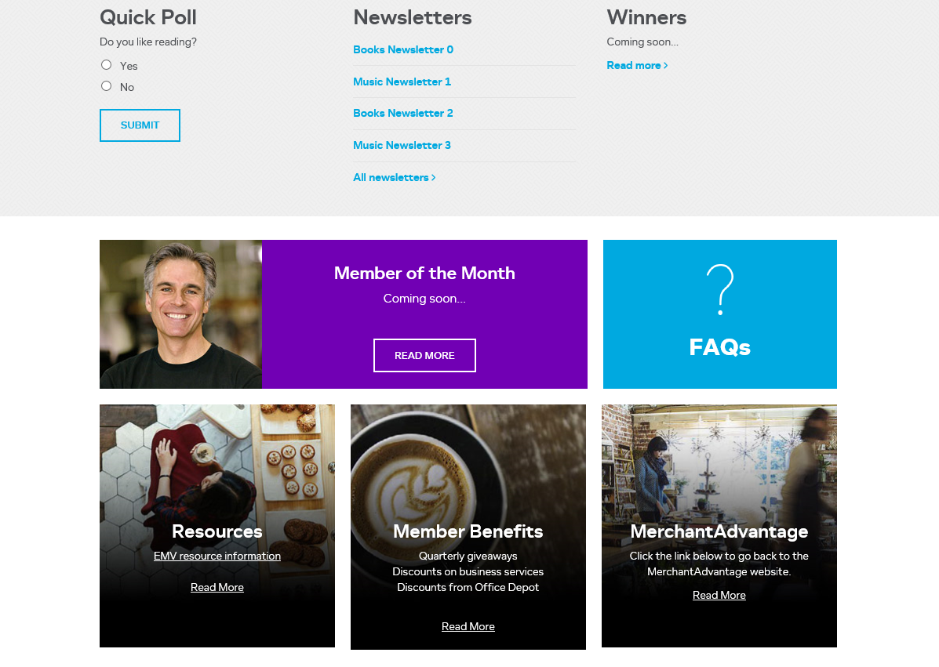

Slide 12
Invitations (Recruitment)
Recruitment plan
Why Join?
Dietary restrictions or favorites

Slide 13
Activities
Calendar
Variety
Fun and engaging
Communicate
Interaction and requests
“How are we doing?”

Slide 14
Party favors (Incentives)
Budget and frequency
Involvement
Surprise and delight
Relevant
Suggestions

Slide 15
Clean up & lessons learned
Drunk uncles
Head chef (and helpers)
Taste test the caterer
Soft launch (try recipes)
Departing guests (monitor membership health)
Don’t make everything from scratch, use what you have

Slide 17
Q&A

Slide 18
Contact Info: Sharon Brant Head of Market Insights sharon.brant@vantiv.com

