Slide 1
The US Traveler Compass Study Partnership: Orbitz and the University of Wisconsin-Madison’s A.C. Nielsen Center for Marketing Research
Speakers: Stacey Symonds, Kristin Branch, Chris Cohen, and Agnes Traye

Slide 2
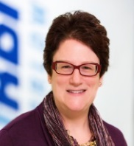
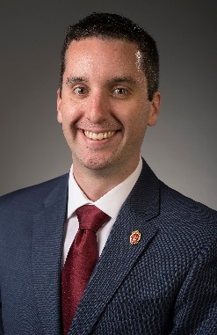
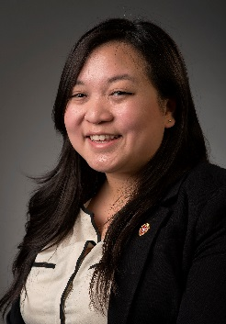
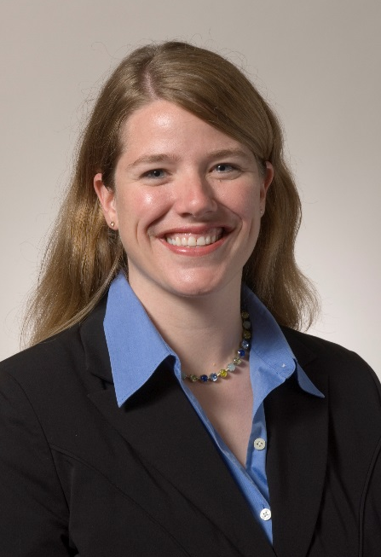
Chris Cohen
MBA Class of 2017
Agnes Traye
MBA Class of 2017
Kristin Branch, Director
A.C. Nielsen Center
Wisconsin School of Business
Stacey Symonds, Senior Director
Customer Experience & Insights
Orbitz & CheapTicket/Expedia Inc. External Advisory Board, A.C. Nielsen Center

Slide 3
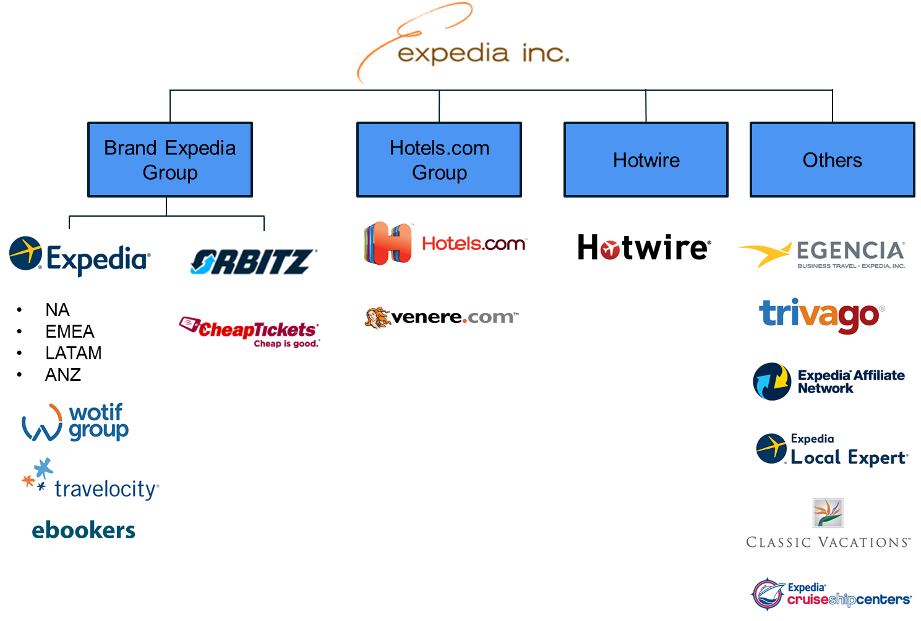
As of September 2015, Orbitz is now part of the Expedia Inc. family of travel brands
Notes:
Stacey

Slide 4
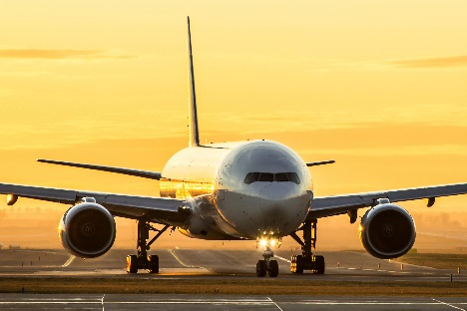
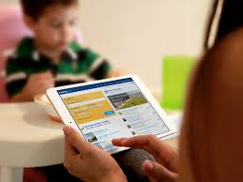
Orbitz adds unique value and expertise to the Expedia Inc. family
Notes:
Stacey

Slide 5
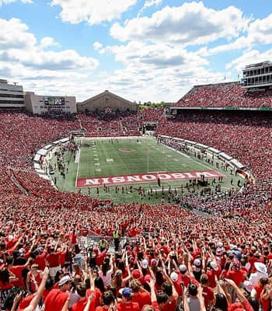
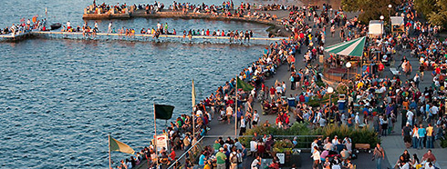
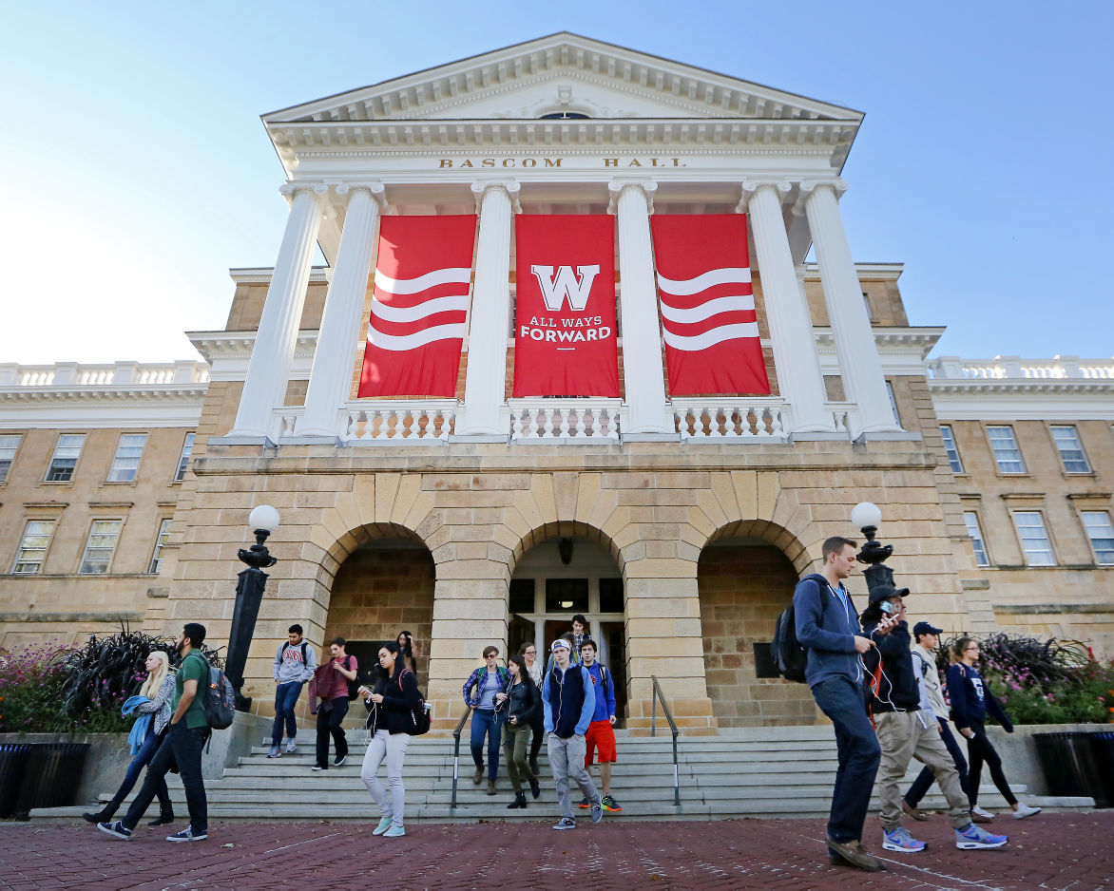
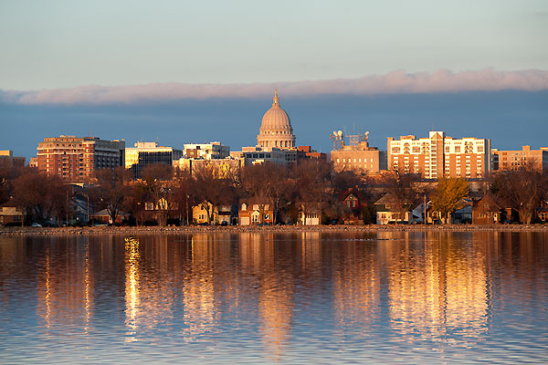
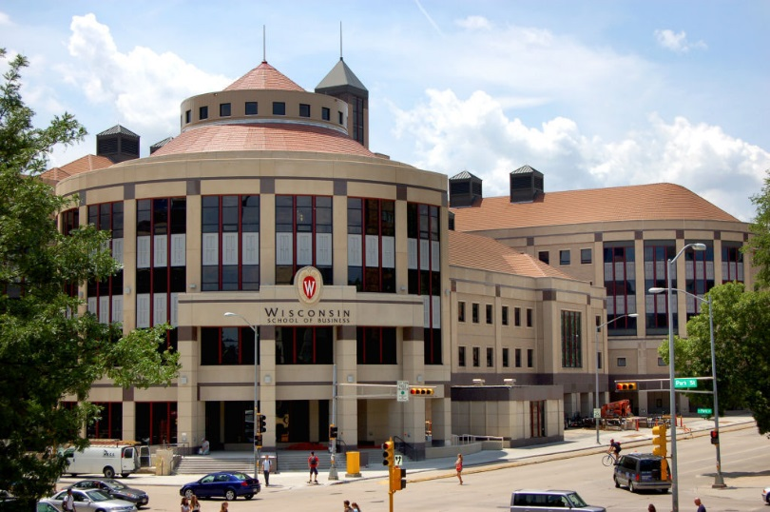
Notes:
Kristin

Slide 6
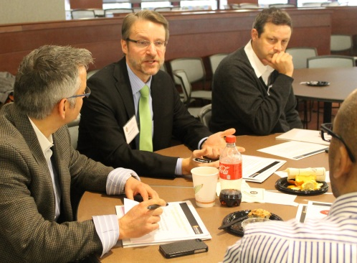
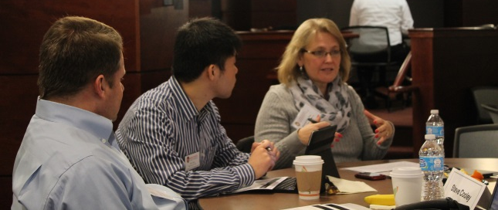
UW’s A.C. Nielsen Center
The premier Marketing Research MBA program
MBA breadth, masters level depth in Marketing Research
Focus on using insights to impact marketing strategy
Applied learning experiences
Guest speakers, case studies & field trips
Consumer Insights Consulting Practicum class
Connected with industry
EAB, alumni & industry friends
Supported by Center staff
Individualized career coaching & educational experiences
MBA & Specialized Curriculum
Industry Applied Learning & Current Topics
Dedicated staff
Industry Connections: EAB, Alumni & Industry Friends
Educating great talent for the industry!
Notes:
Kristin
Review curriculum details here?

Slide 7
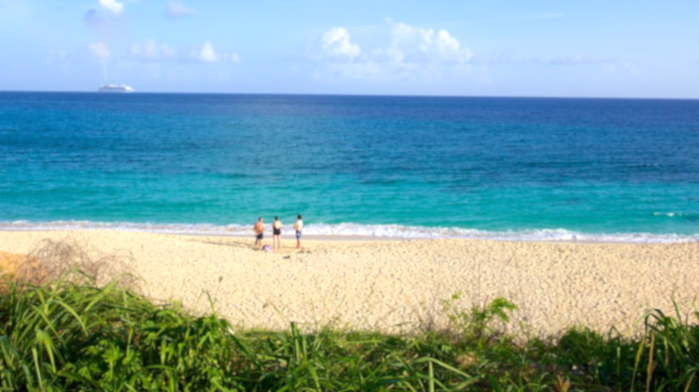
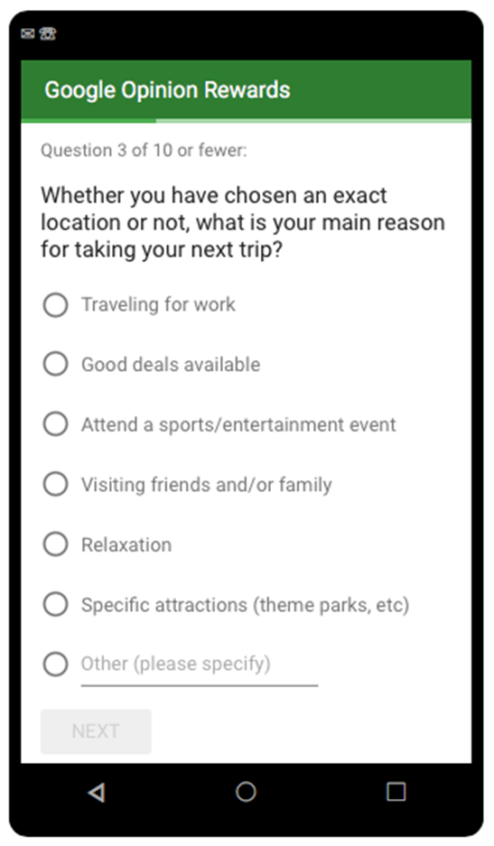
Orbitz’s monthly future travel intent study
Mobile optimized, recurring 10-question monthly survey
Sample: 750-1000+ respondents per month
Topics:
Travel Timing
Destinations
Products (flight, hotel, rental car, etc.)
Budgets
Duration
Changing topical questions
Ongoing tracking:
Month-to-month
Seasonal
Year-over-year
Notes:
Would just mention these topics:
Road trips
Gas prices and effect on travel planning
Tax returns
Concerns about terrorism, Zika virus
Recurring monthly survey using Google Consumer Surveys, started in March 2015
Sample: 750-1000+ respondents each month, screened for those planning leisure travel within three months
Topics include: travel timing, destinations, products included, reasons for travel, budgets, duration, and topical issues
Track month-to-month, seasonal, and year-over-year travel planning changes through survey data analysis
Synthesize findings with internal sales data and other sources

Slide 8
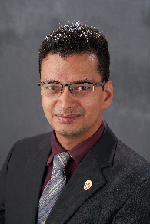
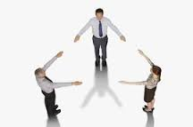
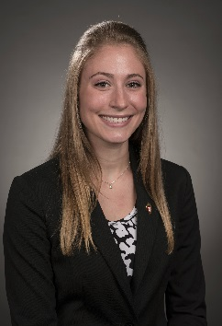
Beneficial to all three parties
Notes:
Triangle: Orbitz – Nielsen Center - Students
What is the project: a monthly survey of travelers intent to take a leisure trip in the next 3 months among adults 18+ in the US.
Who is involved: Orbitz, UW, MBA Students

Slide 9
Beneficial to all three parties
Orbitz:
Quality research at a great value
Student contributions and ideas
Consumer Insight – foundational travel insights, destination trends, market sizing, product interaction, new promotion ideas, topical exploration
PR & social/blog content
Notes:
Stacey can talk through

Slide 10
Beneficial to all three parties
Students:
Learning from doing – survey writing, data analysis, presentation writing / storytelling & giving
Resume enhancement & interviewing examples
Notes:
Stacey can talk through

Slide 11
Great experience building skills for marketing research students
Monthly presentations to marketing and PR teams
Analyzing trends and data changes: month-to-month, seasonal, and year-over year
Survey data analysis, synthesizing data sources
Turning research findings into actionable business insights, influencing new promotional ideas, finding business opportunities
Survey question writing and fine-tuning
Experience teaching other students about marketing research
Highlight of MBA experience!
Notes:
This feels a bit redundant with previous slide, maybe combine the two?
Students continue to gush…

Slide 12
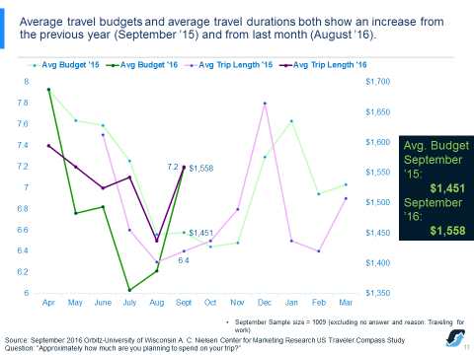
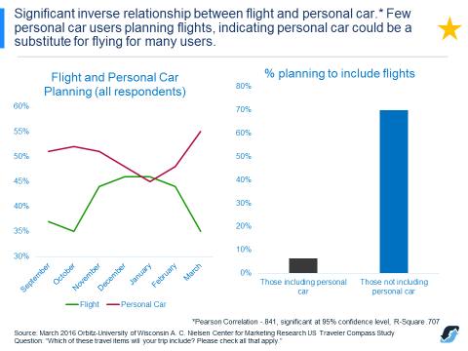
Examples of student analysis:

Slide 13
Beneficial to all three parties
UW & A.C. Nielsen Center
PR for growing awareness of our program,
Student education – inspired applied learning
Revenue to spend on student scholarships
Notes:
Kristin bringing back the UW story to this specific Orbitz study benefits – segue to PR opportunity

Slide 14
We hope to continue this mutually beneficial program for the foreseeable future
Notes:
Triangle: Orbitz – Nielsen Center - Students
What is the project: a monthly survey of travelers intent to take a leisure trip in the next 3 months among adults 18+ in the US.
Who is involved: Orbitz, UW, MBA Students

Slide 15
Q & A
Thank you!
Notes:
Final slide? How do we want to close our presentation?

Slide 16
Back up slides (to be included in ppt share out)

Slide 17
In case you’re interested… UW’s Consumer Insights Consulting Practicum class
A.C. Nielsen Center’s class to facilitate students doing actual marketing research consulting work
Applied learning of marketing research driving business growth
Corporate communication skill development
Project management through conducting research, reporting insights and advising on action steps
Seeking 7-10 clients for student marketing research consulting work
Projects ideally includes primary research – quantitative or qualitative
UW student and Madison area resident sample focusing on 18-30 year olds
Can also include secondary research, data analysis, innovation projects, white paper writing, etc.
Estimated $24,500 ideal semester-long project price plus research costs. Prices based on project scope.
Ideally January – April, but timing can be flexible
A.C. Nielsen Center students in their final semester as a capstone experience prior to graduation
Experienced students through our curriculum and post-internship
Contact Kristin Branch, Kristin.branch@wisc.edu 608-262-9116 to learn more
Notes:
Kristin’s sales pitch as a close?

Slide 18
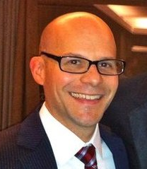
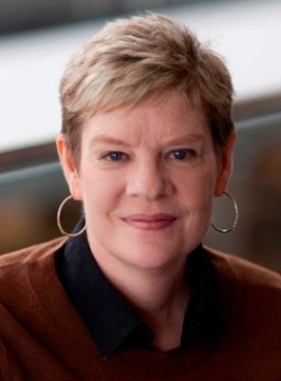
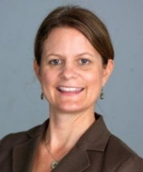
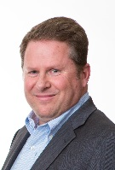
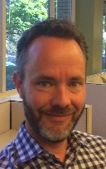
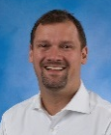
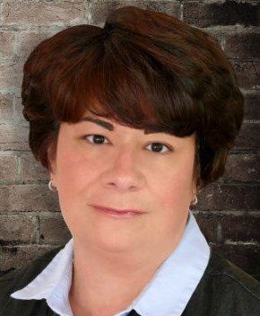
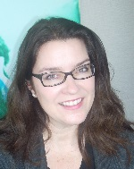
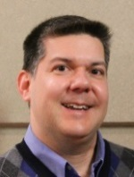
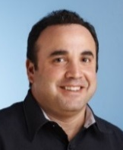
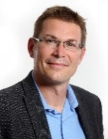
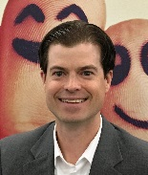
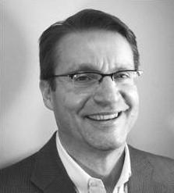
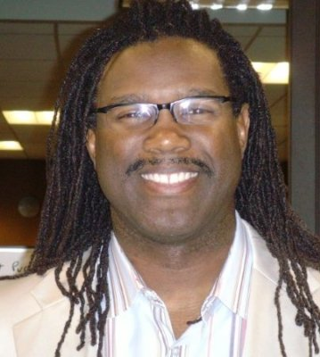
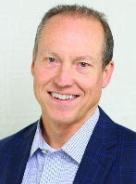
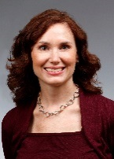
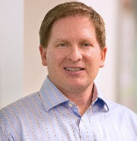
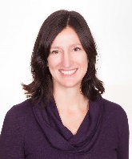
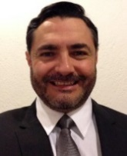
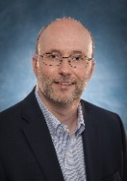
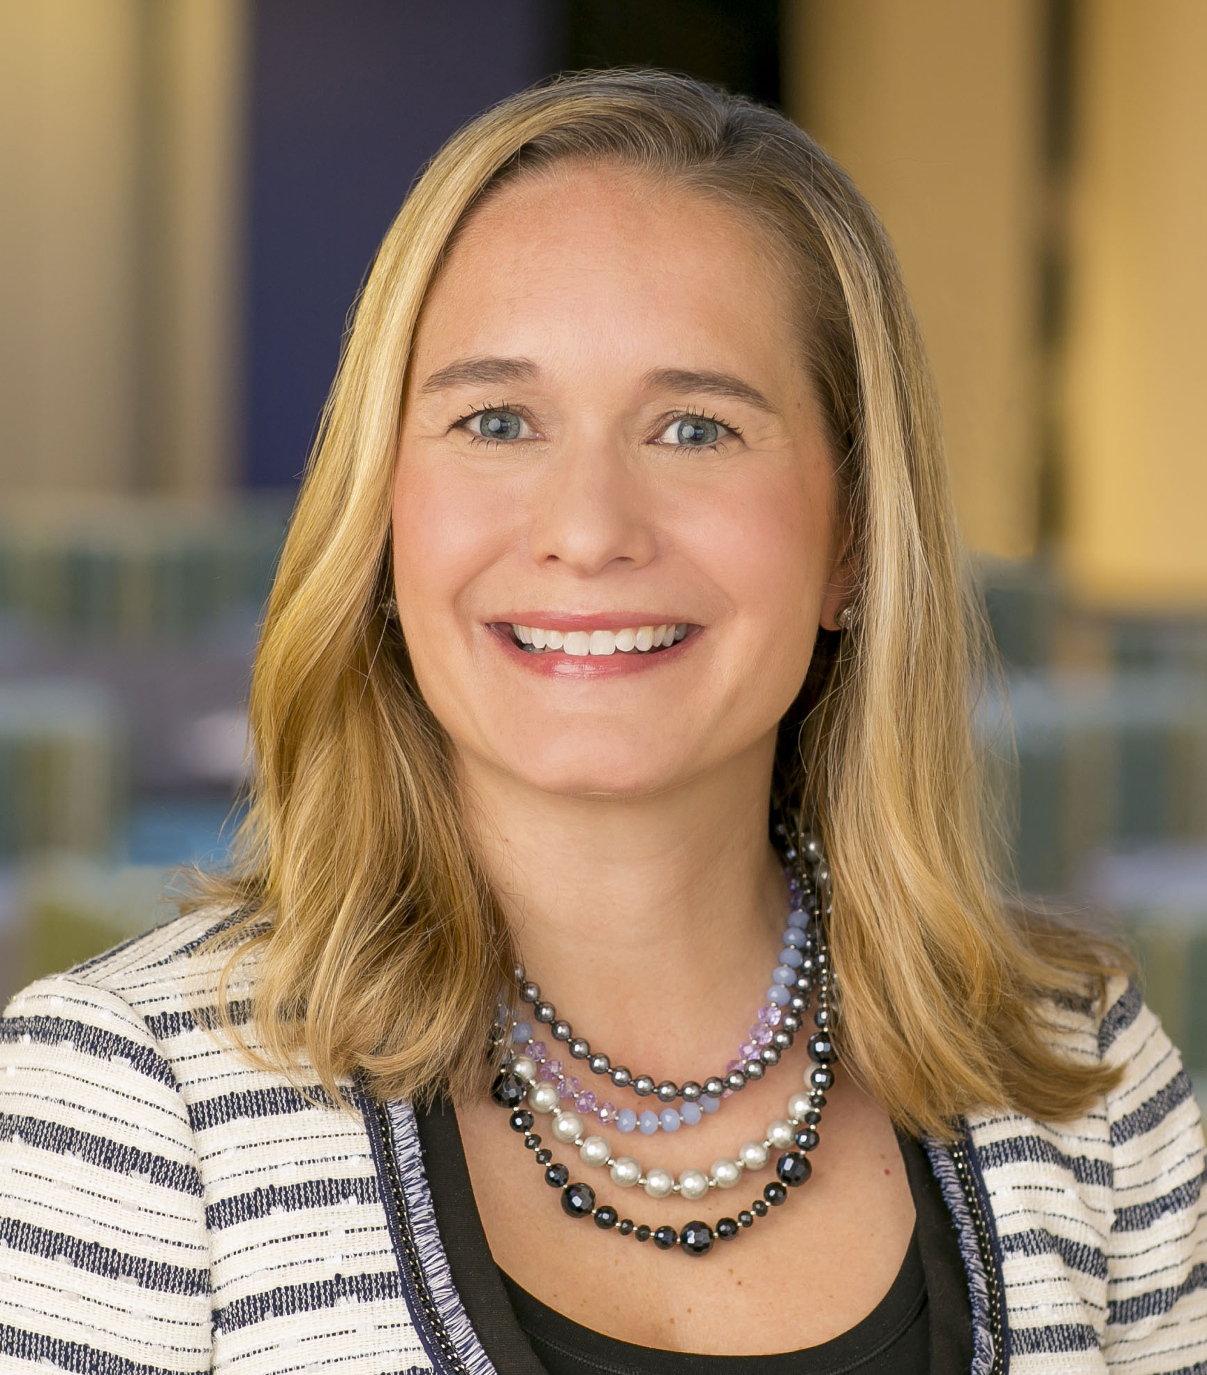
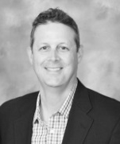
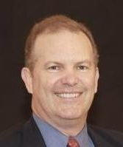
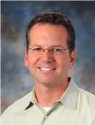
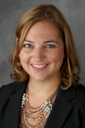
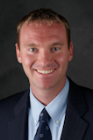
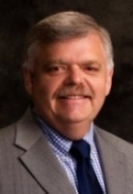
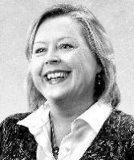
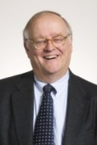
A.C. Nielsen Center’s External Advisory Board
Joseph Bagby
Jeanine Bassett
Beth
Bubon
Steve Cooley
John Copeland
Martyn Crook
Joanne Crudele
Lisa
Gudding
David Guenthner
Kaz
Gunay
Anshu
Gupta
Jami
Guthrie
Brian
Hart
Jackie Hillback
Randall Janisch
Barry Jennings
Jim
Lane
Paul Markowitz
Tara
Marotti
Paul
Metz
Julie Norvaisas
Marcos Perez
Heiko Schafer
Tanya Schooley
Greg
Smith
Stacey
Symonds
Stuart Taylor
Bryan
Vaughn
Alumni Representatives:
Active Friends of the Center:
Cherie Leonard
David Shepherd
Dennis
Degeneffe
Ann
Dencker
Bob
Drane
Jay Luttrell

Slide 20
UW’s A.C. Nielsen Center Alumni Employers

